Slide 1
Exploring Documents as Data
Nakshatra Yalagach and Sara Shallenberger
Data Science for the Public Good (DSPG) Interns
Joanna Schroeder and Joel Thurston
DSPG Team Leads, Social and Decision Analytics Division
Andrew Slaughter, Sponsor
US Army Research Institute for the Behavioral and Social Sciences
3 August 2023

Slide 2
The research described herein was sponsored by the U.S. Army Research Institute for the Behavioral and Social Sciences, Department of the Army (Cooperative Agreement No. W911NF-20-20-027). The views expressed in this presentation are those of the authors and do not reflect the official policy or position of the Department of the Army, DOD, or the U.S. Government.
Notes:
We are embracing new ways to repurpose these existing Army data to measure the social characteristics of individual Soldiers and units.
This research will provide statistical models that forecast and visualize individual and unit performance.

Slide 3
Project Overview
Explore methods to extract Soldier assignments from documents
Analyze text data
Analyze Soldier performance and its connections to psychosocial traits
Contribute our knowledge of large language models (LLMs) to open-source repositories
Part I: Extracting Text From Documents
Part II: Analyzing Data From Documents
Notes:
We are embracing new ways to repurpose these existing Army data to measure the social characteristics of individual Soldiers and units.
This research will provide statistical models that forecast and visualize individual and unit performance.

Slide 4
Part I: Extracting text from documents

Slide 5
Goals
Create a dataset of Officer assignments
Assist the ARI team in modeling soldier career progression
Perform descriptive analysis of Officer assignments
Notes:
Army data sources are administrative records (e.g., demographics, training history, accessions, and attrition data)
Non-DOD data sources – developed process with AAG-RFL for ingestion and curation and making available to all
users

Slide 6
Dataset
Documents from the Smartbook for DA Pam 600-3 Officer Professional Development and Career Management
14 Branches and Functional Areas (FA)
Operations (11 including Armor, Field Artillery, Infantry)
Information Dominance (3: Cyber, Electronic Warfare, Information Operations)
Attributes extracted:
Assignments (e.g., Platoon Leader, Battalion Commander)
Type of Assignment
Key Developmental (KD): most important for promotion
Developmental/Broadening (DEV)
Rank (e.g., Lieutenant, Captain, Major)
Military Occupational Specialty (ex. Infantry)​ | Rank (ex. Lieutenant)​ | Assignment (ex. Executive Officer)​ | Type (ex. Key Developmental)​
Notes:
Army data sources are administrative records (e.g., demographics, training history, accessions, and attrition data)
Non-DOD data sources – developed process with AAG-RFL for ingestion and curation and making available to all
users

Slide 7
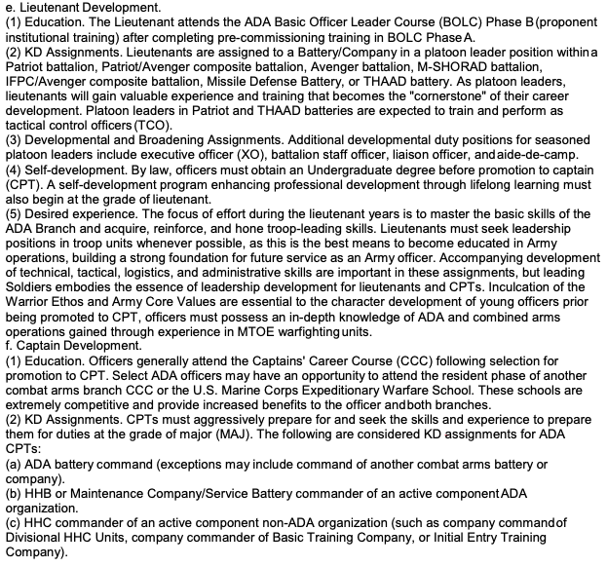

















Sample Document A:
Air Defense
Artillery
Type
Assignments
Ranks
Type
Assignments

Slide 8
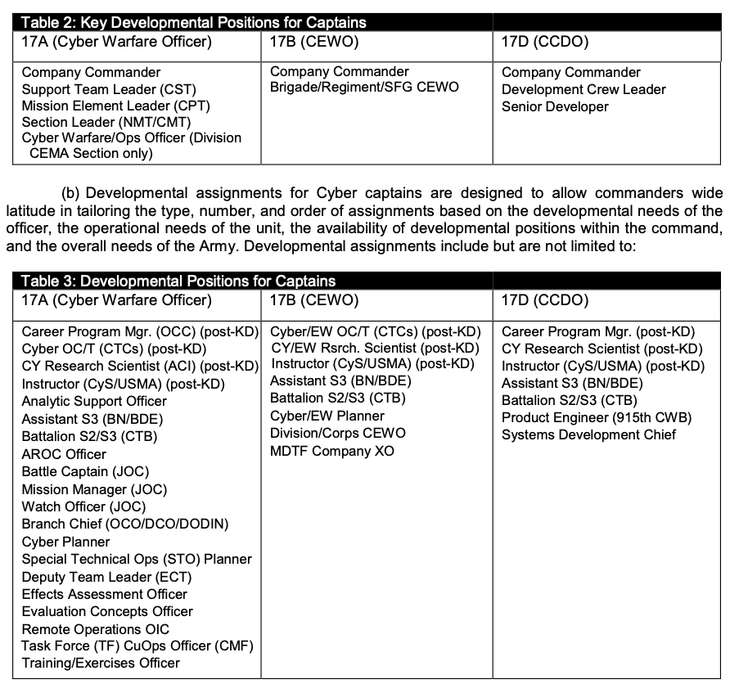










Sample Document B: Cyber Branch
Assignments
Type
Ranks
Assignments

Slide 9
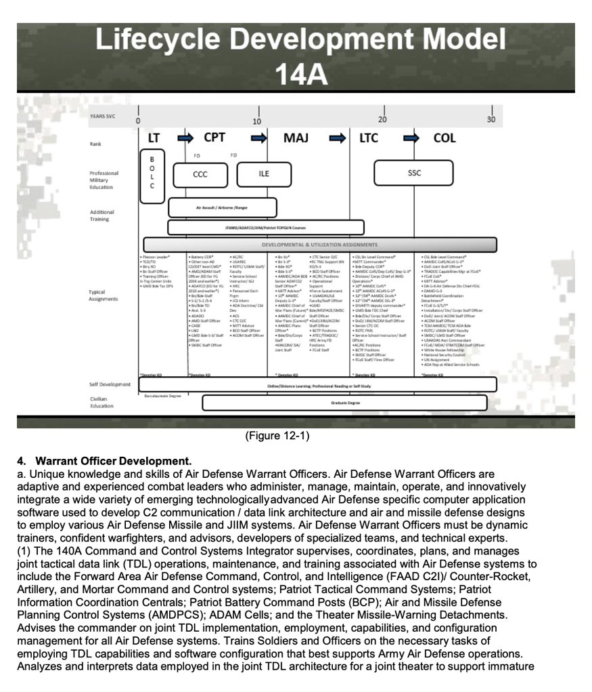
Ranks
Sample Document A: Air Defense Artillery
Type
Assignments

Slide 10
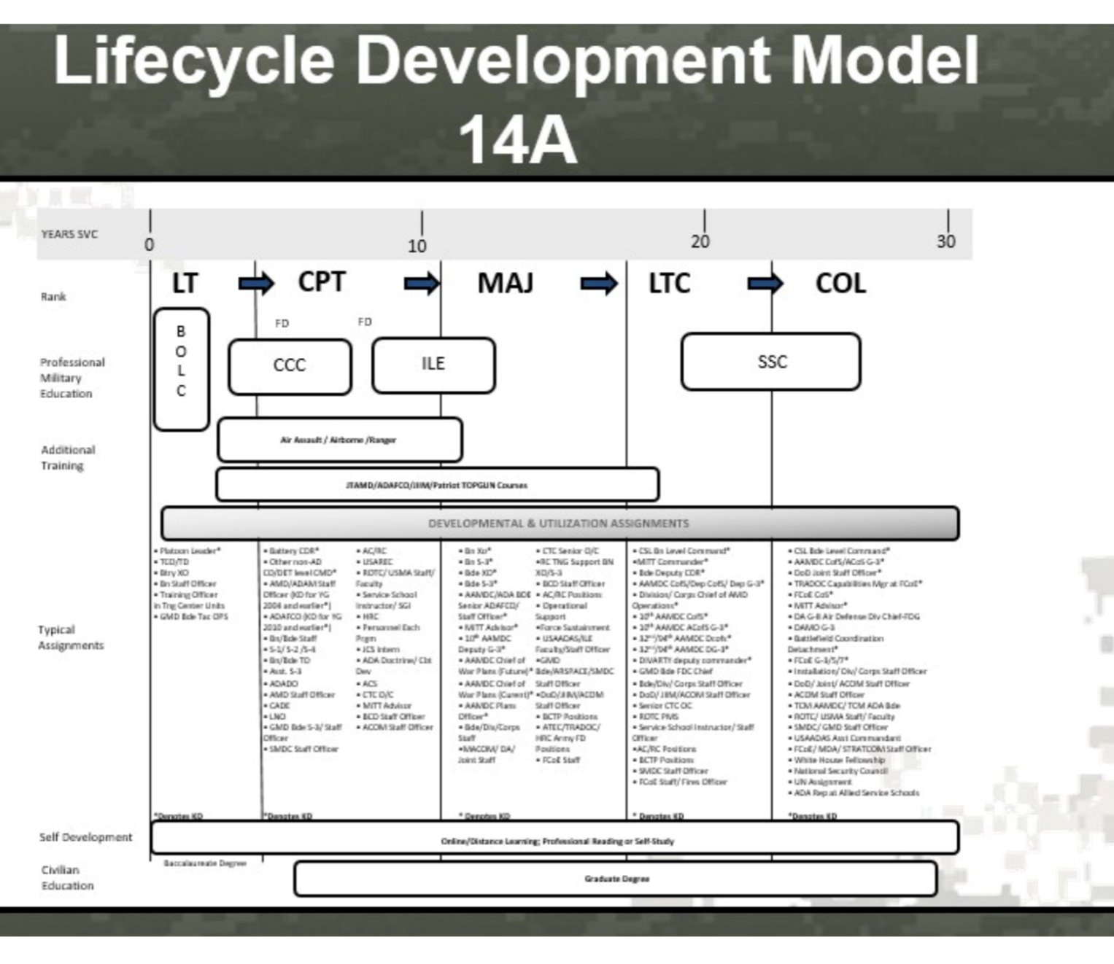
Before Upscaling
Notes:
Work on this after talking to Kathryn

Slide 11
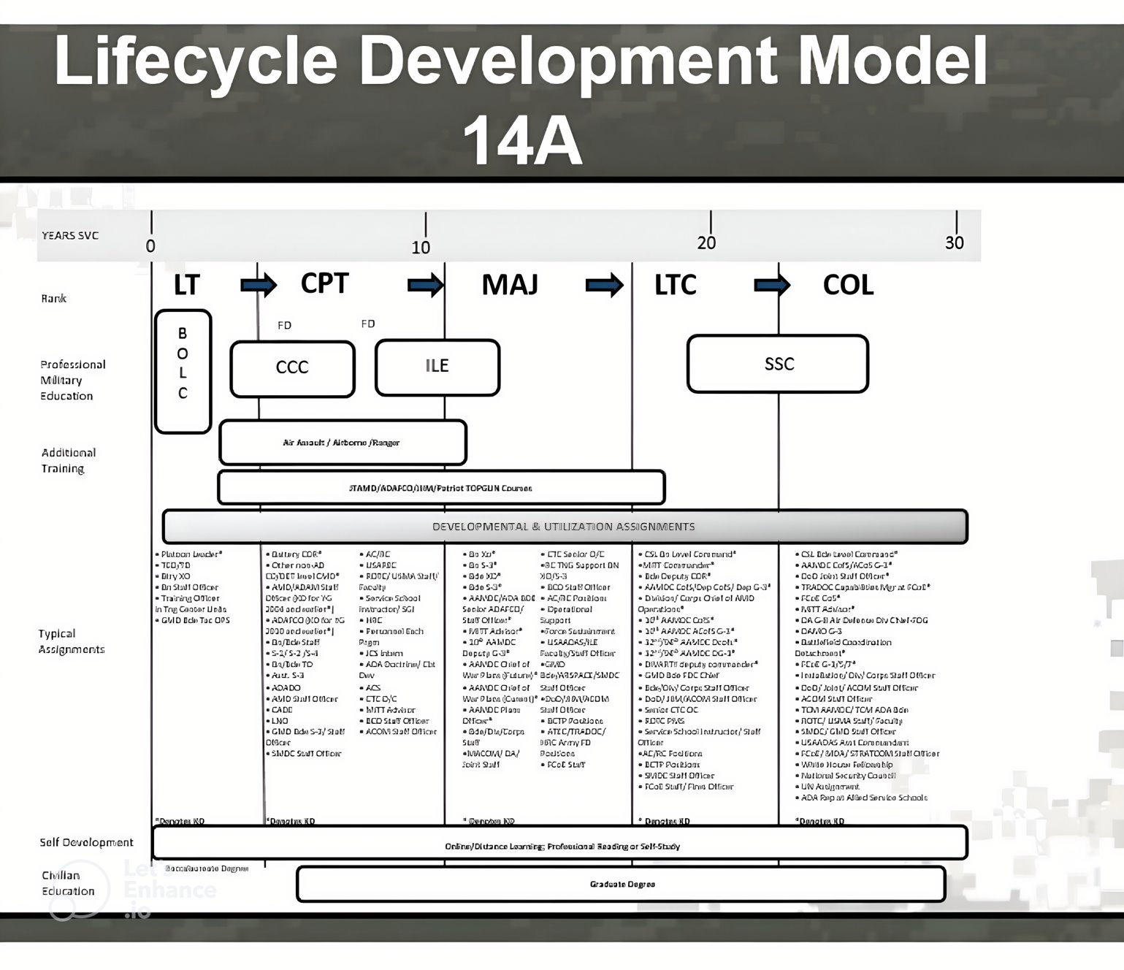
After Upscaling
Notes:
Work on this after talking to Kathryn

Slide 12
Method 1: Image Upscaler
Benefits
Enhanced resolution
Reduced noise
Time efficient
Drawbacks
Distorted results
Illegible
Partial Improvement

Slide 13
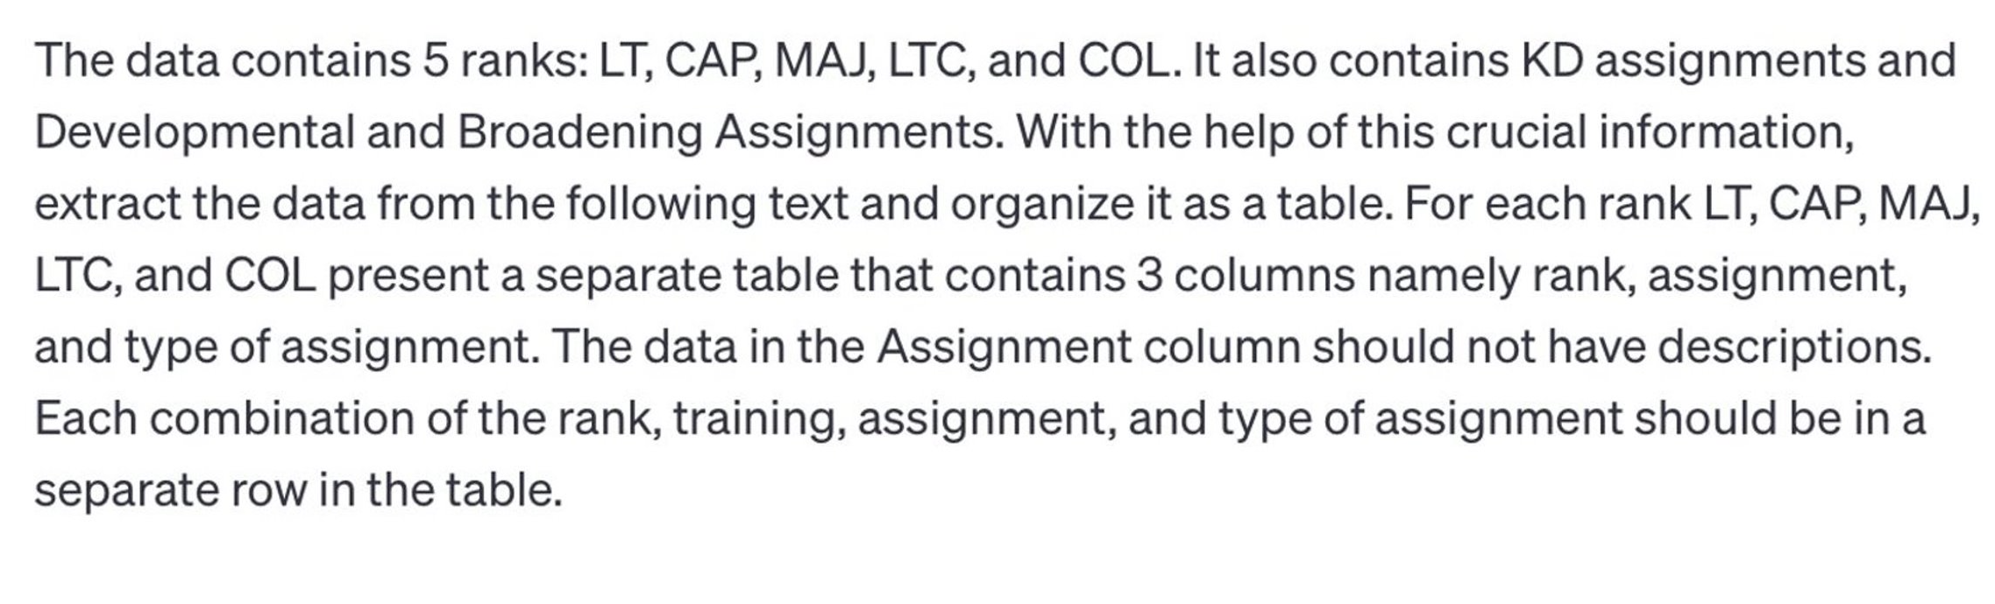



ChatGPT Prompt
Notes:
Work on this after talking to Kathryn

Slide 14
ChatGPT Output
Table 1. Captain
Table 2. Captain
Rank​ | Assignment​ | Type​
CPT | ADA Battery Command​ | KD ​
CPT | HHB or Maintenance Company/Service Battery CMD​ | KD ​
CPT | HHC Commander of non-ADA Organization​ | KD ​
CPT | JTAGS/AN/TPY-2 FBM Detachment Command​ | KD ​
CPT | ADA Brigade/AAMDC Air Defense Artillery Fire Control Officer​ | DEV​
CPT | Patriot Top Gun Positions​ | DEV​
CPT | Multinational Transition Team Trainer​ | DEV​
CPT | CTC Observer/Controller​ | DEV​
CPT | Small Group Instructor​ | DEV​
CPT | ADA Battalion/Brigade Staff Officer​ | DEV​
Table 2. Lieutenant
Rank | Assignment | Type
LT | Battery/Company Platoon Leader | KD
LT | Executive Officer | DEV
LT | Battalion Staff Officer | DEV
LT | Liaison Officer | DEV
LT | Aide-de-Camp | DEV
Notes:
Work on this after talking to Kathryn

Slide 15
Table 3. Major
ChatGPT Output
Rank​​ | Assignment​​ | Type​​
MAJ​ | Battalion/Brigade S-3 or XO of ADA Organization​ | KD​
MAJ​ | Battalion/Brigade S-3 or XO of Combat Arms Unit​ | KD​
MAJ​ | AAMDC Plans Officer​ | KD​
MAJ​ | Senior ADA Fire Control Officer​ | KD​
MAJ​ | CTC Senior O/C​ | DEV​
MAJ​ | ADA Brigade Staff Officer​ | DEV​
MAJ​ | USAADAS/ILE Faculty and Staff Officer​ | DEV​
MAJ​ | Brigade/Division/Corps Staff Officer​ | DEV​
MAJ​ | GMD Brigade/ARSPACE/SMDC Staff Officer​ | DEV​
Table 4. Lieutenant Colonel
Rank​​ | Assignment​​ | Type​​
LTC | Battalion/Brigade Commander | KD
LTC | AAMDC Plans Officer | KD
LTC | Senior ADA Fire Control Officer | KD
LTC | Brigade/Division/Corps Staff Officer | DEV
LTC | GMD Brigade/ARSPACE/SMDC Staff Officer | DEV
LTC | DoD/JIIM/Army/ACOM Staff Officer | DEV
Notes:
Work on this after talking to Kathryn

Slide 16
Table 5. Colonel
ChatGPT Output
Rank​​​ | Assignment​​​ | Type​​​
COL​ | Officer Leader Development​ | KD​
COL​ | Air Defense Artillery Officer Development​ | KD​
COL | Goal​ | KD​
COL | Branch life cycle functions​ | KD​
COL | Acquisition​ | KD​
COL | Individual Training and Education​ | KD​
COL | Distribution​ | KD​
COL | Deployment​ | KD​
COL | Sustainment​ | KD​
COL​ | Promotion​ | KD​
COL​ | Command​ | KD​
COL​ | Officer Evaluation Report (OER)​ | KD​
COL​ | Professional Development​ | KD​
COL​ | Transition​ | KD​
COL​ | Broadening Guiding Principles - Assignments​ | KD​
COL​ | Lieutenant Development​ | DEV​
COL​ | Captain Development​ | DEV​
COL​ | Major Development​ | DEV​
Table 3. Major
Notes:
Work on this after talking to Kathryn

Slide 17
Method 2: ChatGPT Solution
Benefits
Easily and quickly implemented
Applicable across all documents
Re-usable prompts
Equal effectiveness at data extraction across multiple test documents
Drawbacks
Not reproducible
Sensitive to individual user input
Can generate different responses given the same prompt
Less precise extraction of assignments
Notes:
Work on this after talking to Kathryn

Slide 18
Regex
Adopted method

Slide 19
Method 3: Regex Solution
Benefits
Precise
Captures the most unique assignments
Supervised data formatting
Output format (data cleaning and splitting on slashes, commas, etc.) controlled by the scientist
Drawbacks
Time intensive
Unique regex and extraction process for each document
Poorly suited to large sets of documents

Slide 20
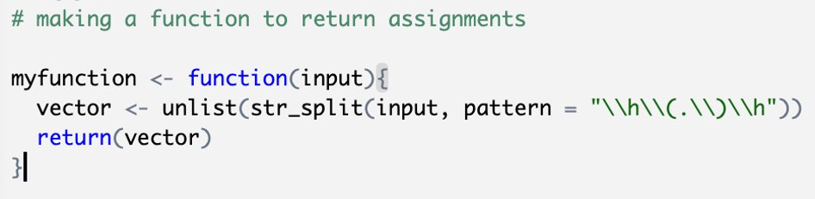
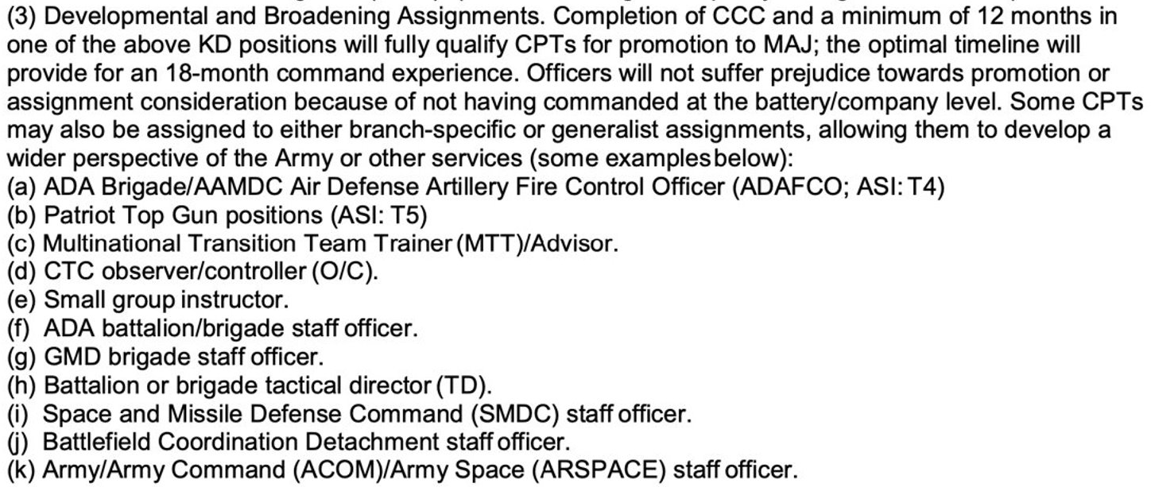
Regex: Sample Input
Sample of a function used to split up assignments:
Function splits up the following paragraph
by its parenthetical delimiters, ex. (a).

Slide 21
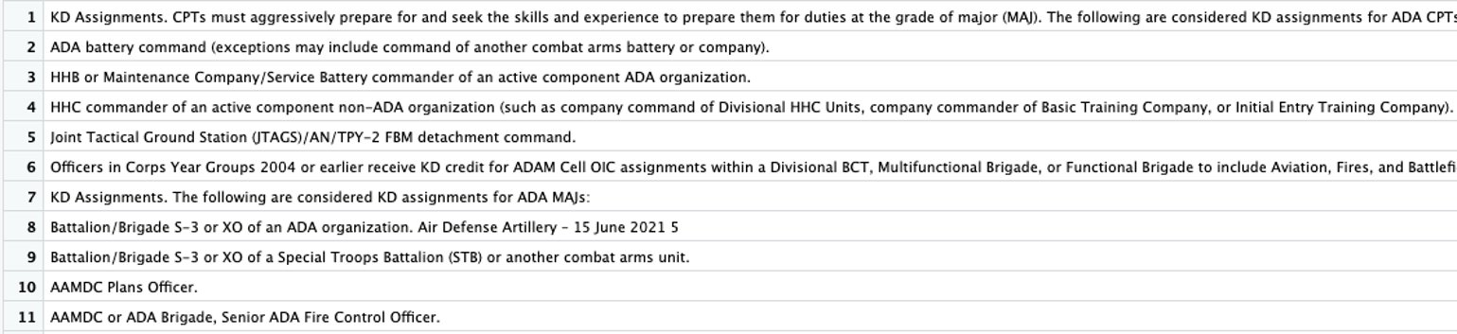
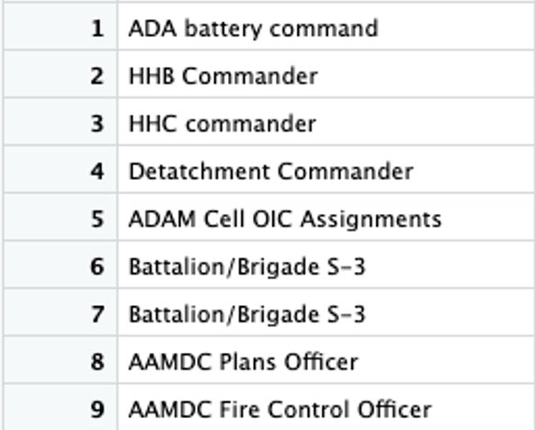
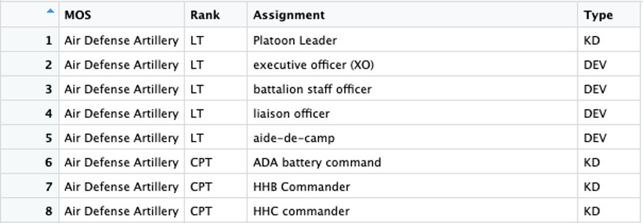
Continued: Regex Process
After function is applied, we get output that looks like this:
After some text cleaning, we get output that looks like this:

Slide 22
Regex: Exploratory Data Analysis
Assignment Type​ | Number of Unique Assignments​
Key Developmental​ | 208
Developmental/Broadening​ | 559
Table 2. Army branches and number of unique assignments in each branch.
Branch​ | Number of Unique Assignments​
Cyber | 142
Air Defense Artillery | 114
Engineers | 90
Chemical | 81
Armor | 80
Infantry | 74
Field Artillery | 70
Military Police | 70
Aviation | 60
Civil Affairs | 41
Information Operations | 36
Electronic Warfare | 32
Psychological Operations | 18
Table 1. Army branch assignment types and number of unique assignments for each type.
Rank​ | Number of Unique Assignments​
Major | 280
Captain | 291
Lieutenant Colonel | 108
Colonel | 194
Lieutenant | 41
Table 3. Army ranks and count of unique assignments for each rank.

Slide 23
Applications
Resulting dataset records all possible positions across the 14 Army branches and functional areas studied
How will this information be used?
Provides SDAD and larger Army analyst community with a novel dataset
The assignment "type" (key developmental or developmental) is particularly important for exploring Soldier promotion
Helpful in analysis of Soldier career progression

Slide 24
Part II: analyzing data from documents

Slide 25
Goal
Use Large Language Models (LLMs) to explore the connection between Soldier performance and psychosocial characteristics
Use Bidirectional Encoder Representations from Transformers (BERT) to create word embeddings
Use cosine similarity to map concepts of performance to specific psychosocial characteristics
Notes:
Army data sources are administrative records (e.g., demographics, training history, accessions, and attrition data)
Non-DOD data sources – developed process with AAG-RFL for ingestion and curation and making available to all
users

Slide 26
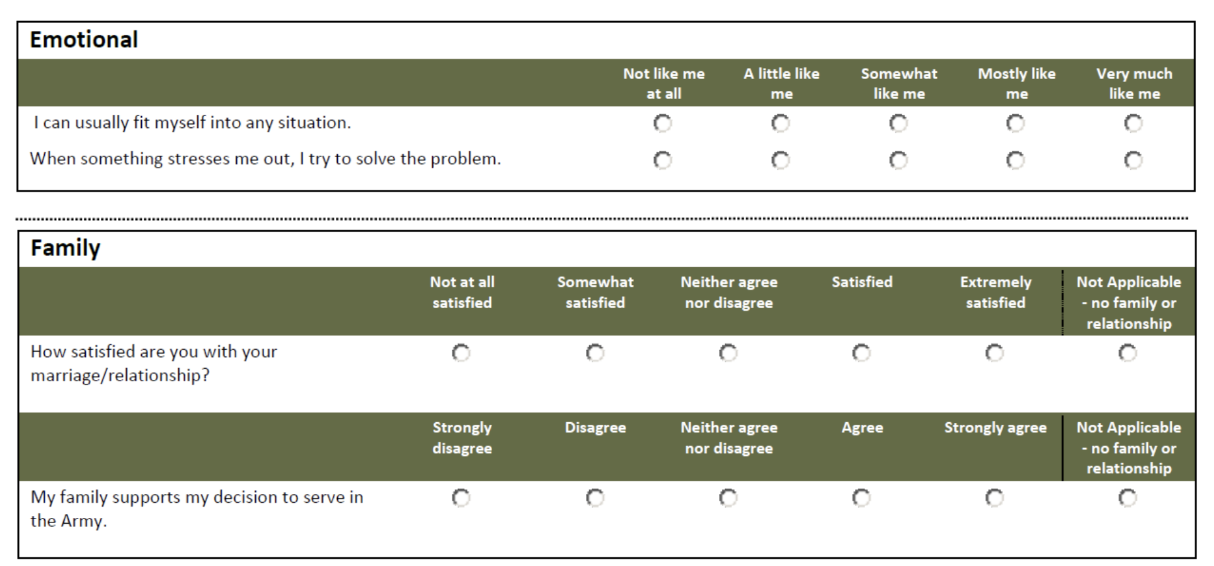
Data: Global Assessment Tool (GAT)
GAT 2.0 Survey (now called the Azimuth Check)
The Army uses the GAT as a holistic assessment tool of Soldier resilience
5 areas of strength: social, emotional, spiritual, family, and physical
GAT item text
Image Attribution
Notes:
Say we didn't focus on the physical dimension
We used the item text, not the scores themselves

Slide 27
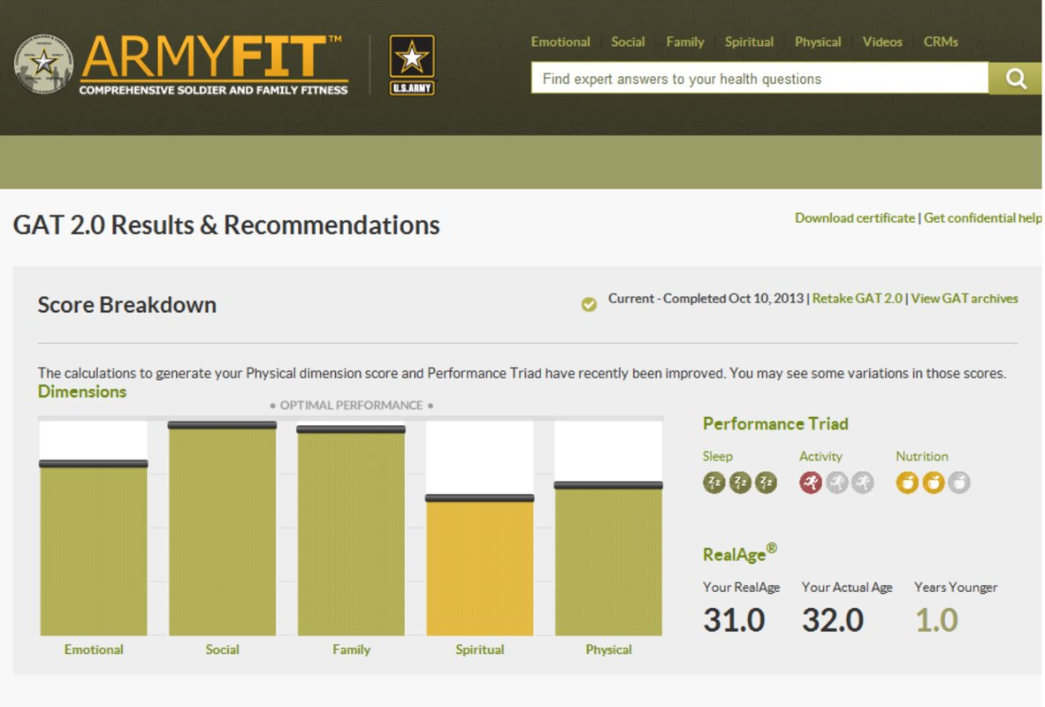
Data: GAT
Sample GAT Results

Slide 28
Data: Army Doctrine Publication (ADP) 6-22
ADP 6-22: Army Leadership and the Profession
Establishes the Army's concepts of leadership and performance
Leadership is a universal quality for all Soldiers
The ADP 6-22 "describes the attributes and core competencies required" of officers
~130 pages
Notes:
Army data sources are administrative records (e.g., demographics, training history, accessions, and attrition data)
Non-DOD data sources – developed process with AAG-RFL for ingestion and curation and making available to all
users

Slide 29
Sentence Embeddings and BERT
BERT (Bidirectional Encoder Representations from Transformers):
Available on Hugging Face
Open-source AI platform to share and train models
Takes context from content before and after a given word
Provides a deeper sense of language context and flow
I can usually fit myself into any situation.
Sentence embeddings
Represents words mathematically with feature vectors
Words with similar meaning have similar vector representations
Notes:
Army data sources are administrative records (e.g., demographics, training history, accessions, and attrition data)
Non-DOD data sources – developed process with AAG-RFL for ingestion and curation and making available to all
users

Slide 30
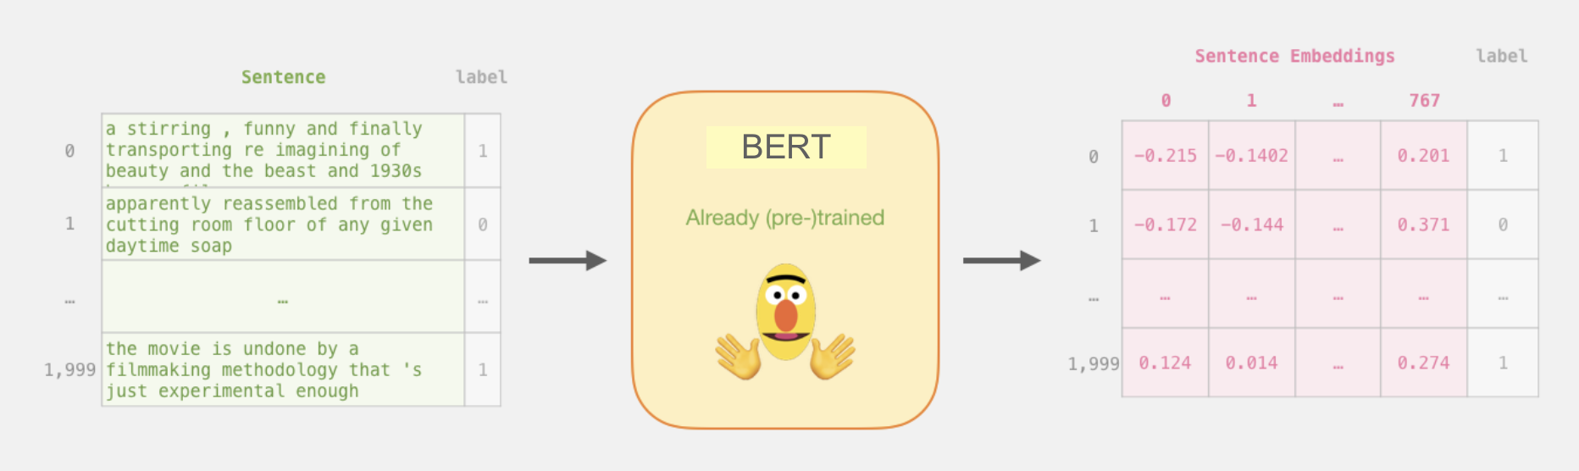
BERT
Image Attribution: http://jalammar.github.io/a-visual-guide-to-using-bert-for-the-first-time/
Notes:
Army data sources are administrative records (e.g., demographics, training history, accessions, and attrition data)
Non-DOD data sources – developed process with AAG-RFL for ingestion and curation and making available to all
users

Slide 31
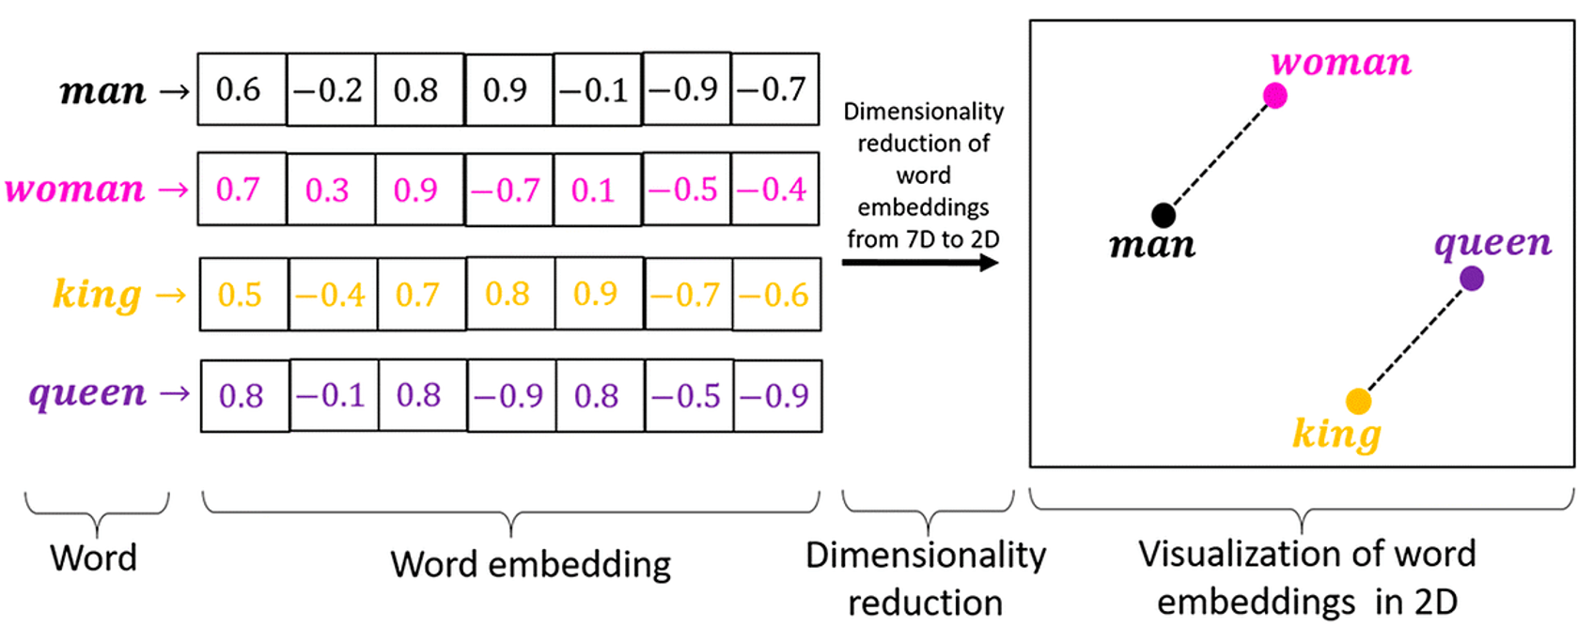
Cosine Similarity
Image Attribution: https://medium.com/@hari4om/word-embedding-d816f643140

Slide 32
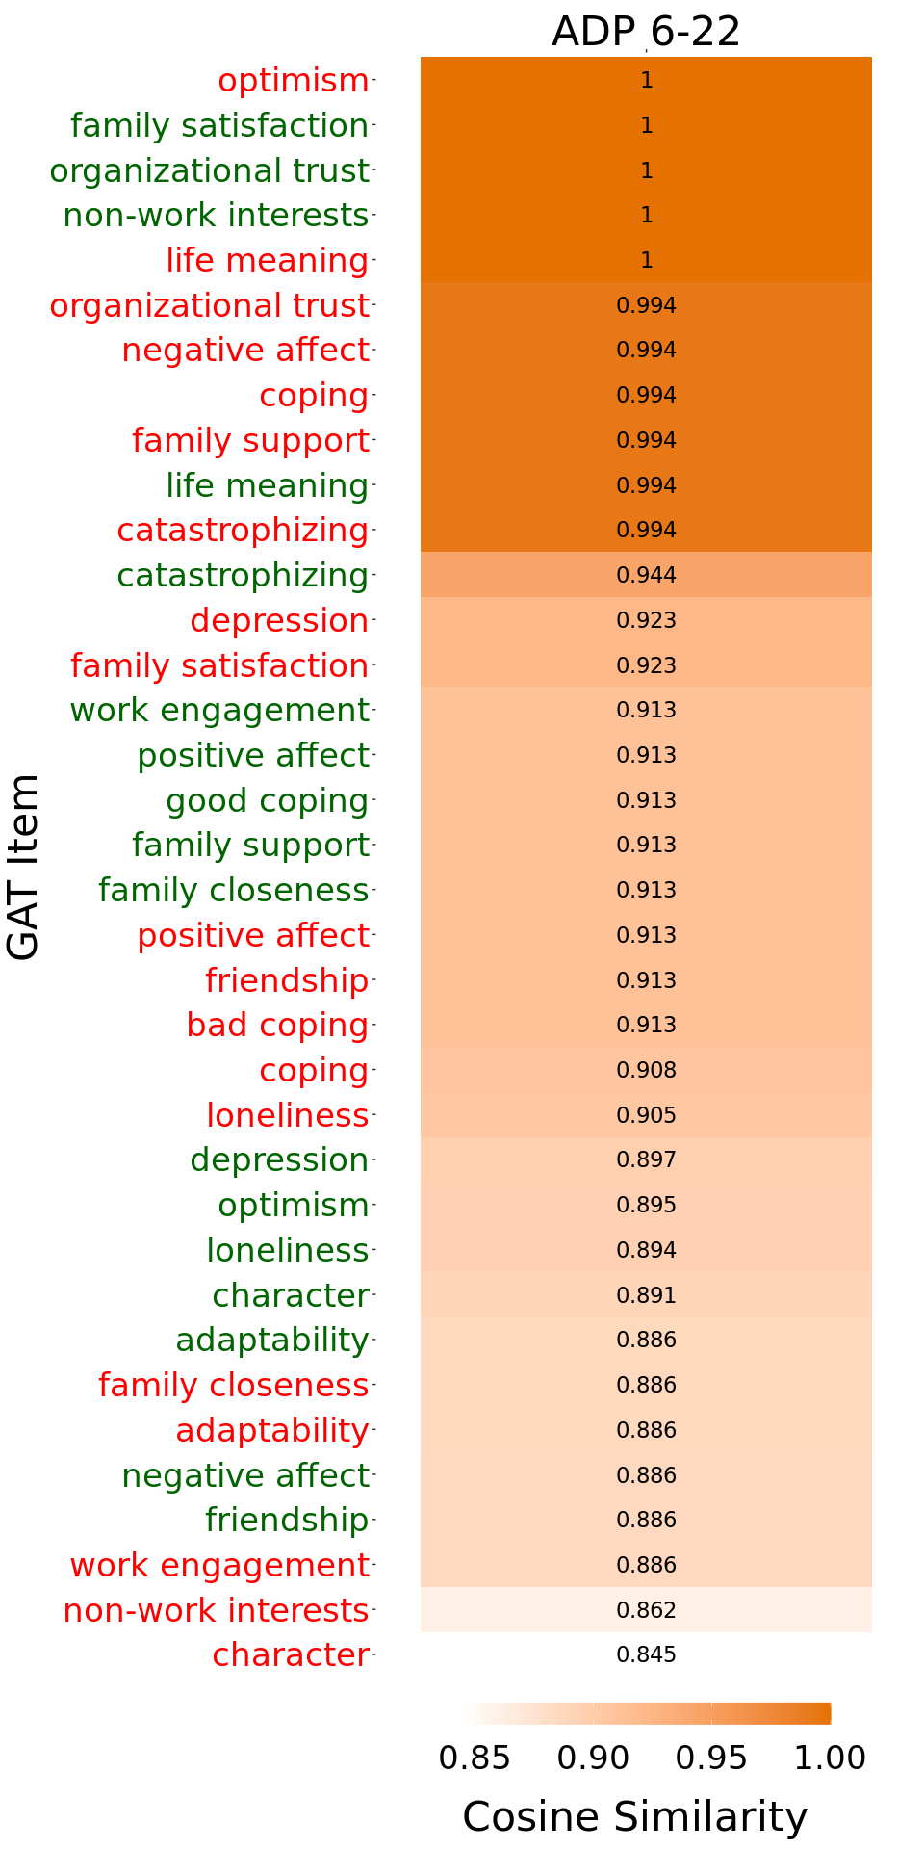
Results
36 GAT items
18 representing good performer
18 representing bad performer
Cosine Similarity Between ADP 6-22 and GAT Items
GAT items with high cosine similarity to the ADP 6-22 document have high similarity in their word embeddings (i.e., high conceptual similarity)
Notes:
Army data sources are administrative records (e.g., demographics, training history, accessions, and attrition data)
Which items from the GAT are most reflected in the ADP 6-22 document?
In other words, what characteristics described in the GAT are most consistent with the Army's definition of ideal performance?
"Good" performers in friendship and negative affect questions
These are responses like:
"In the past four weeks I've never felt guilty"
"I do have someone to talk to when I feel down"
"Bad" performers in character, non-work interests, and work engagement questions
These are responses like:
"In the last four weeks I have never acted with Teamwork."
"I do not spend time at interests or hobbies other than work"
It is not like me at all that How I do in my job influences how I feel.
Non-DOD data sources – developed process with AAG-RFL for ingestion and curation and making available to all
users

Slide 33
Discussion
Overall, all GAT Items are relatively conceptually similar to ADP 6-22
Items corresponding to both good and bad performance are conceptually similar to ADP 6-22
The ADP 6-22 discusses "negative" traits (i.e. traits that leaders should not have) in addition to positive ones
Notes:
Army data sources are administrative records (e.g., demographics, training history, accessions, and attrition data)
Non-DOD data sources – developed process with AAG-RFL for ingestion and curation and making available to all
users

Slide 34

Questions?

